Slide 1
YEAR 9/10 Arts Faculty
Drama

Slide 2
DRAMA/PERFORMING ARTS
Year 9 Electives
Semester 1: Lights/Sets/Action
Semester 2: Drama - Suitcase Series
Year 10 Electives
Semester 1: Wakakirri (Production)
Semester 2: Drama - Unit 1

Slide 3
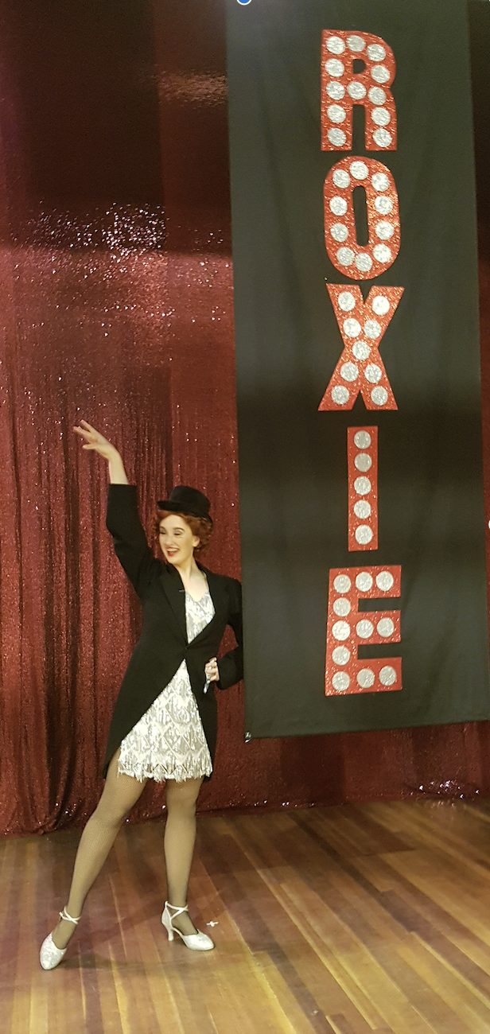
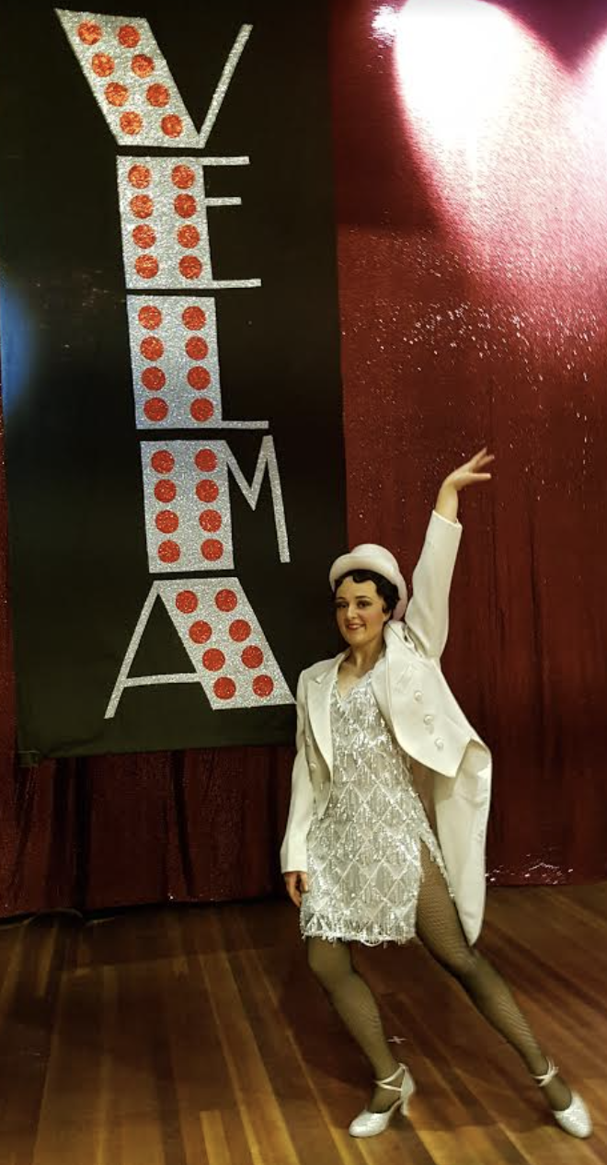
Lights/Sets/Action
Students will be given the opportunity to be involved in all areas of a the production process including:
Lighting Design and Operation
Set Design and Construction
Costume Design and Construction
Sound Design
Makeup and Hair Design
Promotions and Publicity
General Stagecraft
Students are invited to be part of the school’s annual productions.

Slide 4
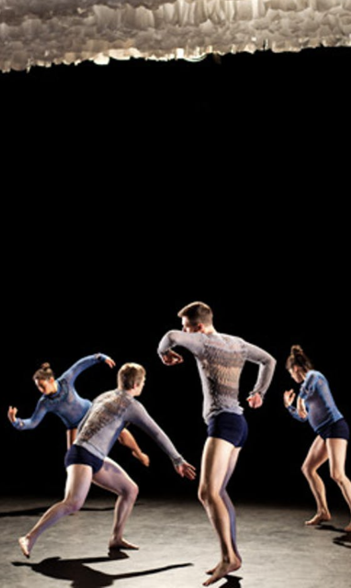
Year 9 Drama - Introduction to Character/Suitcase Series
Students are introduced the the actor’s craft and explore these skills through monologue and playmaking.
Shakespearean Monologue
Character Devised Solo
Students also take part in a collaborative project focussing on Climate Change. This involves devising, rehearsing and performing to peers.
Suitcase Series (Malthouse)
Performance Analysis

Slide 5
Year 10 - Wakakirri/Introduction to Event Management
Students form part of a creative team that devise, develop, create and produce a story-dance item for the national dance competition, Wakakirri.Students will engage in
Design - Costume, Set, Make and Lighting
Choreography, Movement and Acting
Teaching and Coaching
Event management

Slide 6
Drama - Year 10 (Unit 1 VCE)
This subject is an introduction to VCE Drama Unit 1 – Dramatic Storytelling
Area of Study 1: Outcome 1 Creating a Devised Performance Focuses on devising solo and/or ensemble performance/s through the use of stimulus materials. Exploring character using Naturalism and Non-naturalism, Performance Styles, dramatic elements, theatrical conventions, stagecraft and play-making techniques.
Area of Study 2: Outcome 2 Presenting a Devised PerformanceFocusing on presenting solo and/or ensemble performance/s devised for Outcome 1 by manipulating expressive skills, dramatic elements and incorporating and manipulating stagecraft and creating actor-audience relationships.

Slide 7
Drama - Year 10 (Unit 1 VCE) - continued
Area of Study 3: Outcome 3 Analysing a Devised Performance
Focus on observation and analysis of own performance work, reflection and articulation of work processes and uses the language of drama.
Area of Study 4: Outcome 4 Analysing Drama Performances Presented by Other Practitioners
With observation and analysis of a professional performance, using the language of drama to analyse characterisation, dramatic elements, theatrical conventions & stagecraft, performance styles and actor-audience relationships.

